Slide 1
SI485i : NLP
Set 10
Lexical Relations
slides adapted from Dan Jurafsky and Bill MacCartney

Slide 2
Three levels of meaning
Lexical Semantics (words)
Sentential / Compositional / Formal Semantics
Discourse or Pragmatics
meaning + context + world knowledge

Slide 3
The unit of meaning is a sense
One word can have multiple meanings:
Instead, a bank can hold the investments in a custodial account in the client’s name.
But as agriculture burgeons on the east bank, the river will shrink even more.
A word sense is a representation of one aspect of the meaning of a word.
bank here has two senses

Slide 4
Terminology
Lexeme: a pairing of meaning and form
Lemma: the word form that represents a lexeme
Carpet is the lemma for carpets
Dormir is the lemma for duermes
The lemma bank has two senses:
Financial insitution
Soil wall next to water
A sense is a discrete representation of one aspect of the meaning of a word

Slide 5
Relations between words/senses
Homonymy
Polysemy
Synonymy
Antonymy
Hypernymy
Hyponymy
Meronymy

Slide 6
Homonymy
Homonyms: lexemes that share a form, but unrelated meanings
Examples:
bat (wooden stick thing) vs bat (flying scary mammal)
bank (financial institution) vs bank (riverside)
Can be homophones, homographs, or both:
Homophones: write and right, piece and peace
Homographs: bass and bass

Slide 7
Homonymy, yikes!
Homonymy causes problems for NLP applications:
Text-to-Speech
Information retrieval
Machine Translation
Speech recognition
Why?
Notes:
TTS: homographs like “bass” and “bass”
IR: polysemy: “bat care”

Slide 8
Polysemy
Polysemy: when a single word has multiple related meanings (bank the building, bank the financial institution, bank the biological repository)
Most non-rare words have multiple meanings

Slide 9
Polysemy
The bank was constructed in 1875 out of local red brick.
I withdrew the money from the bank.
Are those the same meaning?
We might define meaning 1 as: “The building belonging to a financial institution”
And meaning 2: “A financial institution”

Slide 10
How do we know when a word has more than one sense?
The “zeugma” test!
Take two different uses of serve:
Which flights serve breakfast?
Does America West serve Philadelphia?
Combine the two:
Does United serve breakfast and San Jose? (BAD, TWO SENSES)
Notes:
comes from the Greek word “yoke”, like yoking two oxen together – can they pull the plow?

Slide 11
Synonyms
Word that have the same meaning in some or all contexts.
couch / sofa
big / large
automobile / car
vomit / throw up
water / H₂0

Slide 12
Synonyms
But there are few (or no) examples of perfect synonymy.
Why should that be?
Even if many aspects of meaning are identical
Still may not preserve the acceptability based on notions of politeness, slang, register, genre, etc.
Example:
Big/large
Brave/courageous
Water and H₂0

Slide 13
Antonyms
Senses that are opposites with respect to one feature of their meaning
Otherwise, they are very similar!
dark / light
short / long
hot / cold
up / down
in / out

Slide 14
Hyponyms and Hypernyms
Hyponym: the sense is a subclass of another sense
car is a hyponym of vehicle
dog is a hyponym of animal
mango is a hyponym of fruit
Hypernym: the sense is a superclass
vehicle is a hypernym of car
animal is a hypernym of dog
fruit is a hypernym of mango
hypernym | vehicle | fruit | furniture | mammal
hyponym | car | mango | chair | dog
Notes:
Actually, hyponymy can be subdivided into INSTANCE-OF and SUBCLASS-OF.
The terminology is a bit inconsistent. Some use “hyponymy” to refer to both; others, only for for SUBCLASS-OF.
WordNet breaks out INSTANCE-OF relations separately, but in their help text etc. they do describe it as a form of hyponymy.

Slide 15
WordNet
A hierarchically organized lexical database
On-line thesaurus + aspects of a dictionary
Versions for other languages are under development
http://wordnetweb.princeton.edu/perl/webwn
Category | Unique Forms
Noun | 117,097
Verb | 11,488
Adjective | 22,141
Adverb | 4,601
Notes:
What’s missing from WordNet?

Slide 16
WordNet “senses”
The set of near-synonyms for a WordNet sense is called a synset (synonym set)
Example: chump as a noun to mean
‘a person who is gullible and easy to take advantage of’
gloss: (a person who is gullible and easy to take advantage of)
Each of these senses share this same gloss

Slide 17
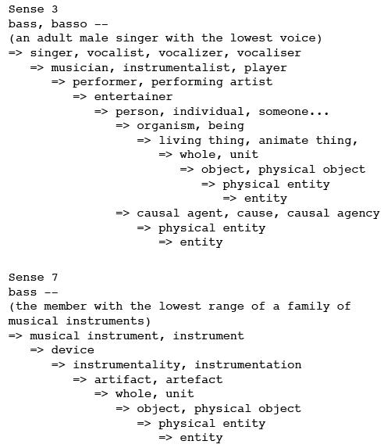
WordNet Hypernym Chains
Notes:
Note that the hypernym hierarchy is not stricly a tree – it is actually a DAG.
ACTUALLY, version 3.0 of WordNet had a cycle, which I pointed out to them, and they fixed!
“restrain” and “inhibit” were direct hypernyms of each other!
now it’s {restrain} < {prevent, keep} > {impede, hinder} > {inhibit, bottle up, suppress}

Slide 18
Word Similarity
Synonymy is binary, on/off, they are synonyms or not
We want a looser metric: word similarity
Two words are more similar if they share more features of meaning
Notes:
Why do we want a looser metric?

Slide 19
Why word similarity?
Information retrieval
Question answering
Machine translation
Natural language generation
Language modeling
Automatic essay grading
Document clustering
Notes:
Let’s talk about some examples

Slide 20
Two classes of algorithms
Thesaurus-based algorithms
Based on whether words are “nearby” in Wordnet
Distributional algorithms
By comparing words based on their distributional context in corpora
Notes:
Pros & cons of thesaurus-based approaches vs. distributional approaches?

Slide 21
Thesaurus-based word similarity
Find words that are connected in the thesaurus
Synonymy, hyponymy, etc.
Glosses and example sentences
Derivational relations and sentence frames
Similarity vs Relatedness
Related words could be related any way
car, gasoline: related, but not similar
car, bicycle: similar

Slide 22
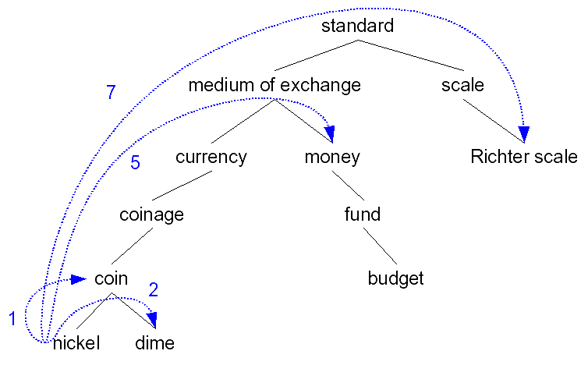
Path-based similarity
Idea: two words are similar if they’re nearby in the thesaurus hierarchy (i.e., short path between them)
Notes:
Actually this is for similarity (actually, relatedness) between _senses_, not words. What if we want similarity between _words_?

Slide 23
Tweaks to path-based similarity
pathlen(c₁, c₂) = number of edges in the shortest path in the thesaurus graph between the sense nodes c₁ and c₂
sim_{path}(c₁, c₂) = – log pathlen(c₁, c₂)
wordsim(w₁, w₂) =
max c₁∈senses(w₁), c₂∈senses(w₂) sim(c₁, c₂)
Notes:
Why –log(pathlen)? Gives it the right slope (yay), but makes everything negative (boo), and also not bounded (boo).
So what’s wrong with this path-based similarity?
[back up and show the graph again]

Slide 24
Problems with path-based similarity
Assumes each link represents a uniform distance
nickel to money seems closer than nickel to standard
Seems like we want a metric which lets us assign different “lengths” to different edges — but how?

Slide 25
From paths to probabilities
Don’t measure paths. Measure probability?
Define P(c) as the probability that a randomly selected word is an instance of concept (synset) c
P(ROOT) = 1
The lower a node in the hierarchy, the lower its probability
Notes:
So how would you estimate P(c) from a corpus (for every c in, say, the WordNet hypernym hierarchy)?

Slide 26

Estimating concept probabilities
Train by counting “concept activations” in a corpus
Each occurence of dime also increments counts for coin, currency, standard, etc.
More formally:

Slide 27
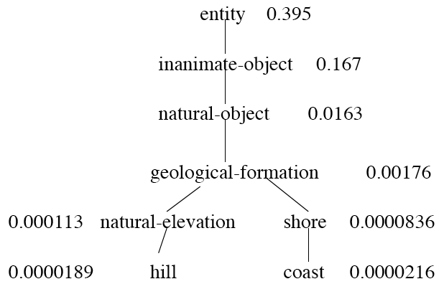
Concept probability examples
WordNet hierarchy augmented with probabilities P(c):
Notes:
Note that “entity” is not the sole “unique beginner”. In fact, there are 9 (or 11). Also: psychological_feature, abstraction, state, event, act, group, possession, phenomenon.

Slide 28
Information content: definitions
Information content:
IC(c)= – log P(c)
Lowest common subsumer
LCS(c₁, c₂) = the lowest common subsumer I.e., the lowest node in the hierarchy that subsumes (is a hypernym of) both c₁ and c₂
We are now ready to see how to use information content IC as a similarity metric

Slide 29
Information content examples
WordNet hierarchy augmented with information content IC(c):
0.403
0.777
1.788
2.754
3.947
4.078
4.724
4.666

Slide 30
Resnik method
The similarity between two words is related to their common information
The more two words have in common, the more similar they are
Resnik: measure the common information as:
The information content of the lowest common subsumer of the two nodes
sim_{resnik}(c₁, c₂) = – log P(LCS(c₁, c₂))
Notes:
If the LCS is ROOT, what is the Resnik similarity [0]
What is the range of this similarity function? [0, infinity]

Slide 31
Resnik example
sim_{resnik}(hill, coast) = ?
0.403
0.777
1.788
2.754
3.947
4.078
4.724
4.666
Notes:
2.754
What about sim_resnik(natural-elevation, shore)? Or sim_resnik(hill, shore)?

Slide 32
Some Numbers
Let’s examine how the various measures compute the similarity between gun and a selection of other words:
w2 IC(w2) lso IC(lso) Resnik
----------- --------- -------- ------- ------- ------- -------
gun 10.9828 gun 10.9828 10.9828
weapon 8.6121 weapon 8.6121 8.6121
animal 5.8775 object 1.2161 1.2161
cat 12.5305 object 1.2161 1.2161
water 11.2821 entity 0.9447 0.9447
evaporation 13.2252 [ROOT] 0.0000 0.0000
IC(w2): information content (negative log prob) of (the first synset for) word w2 lso: least superordinate (most specific hypernym) for "gun" and word w2. IC(lso): information content for the lso.
Notes:
I think on this slide IC, Resnik, and JC are measured in bits, whereas in preceding slides information was measured in nats. So the absolute values are 3.32x bigger here. But it doesn’t really matter.

Slide 33
The (extended) Lesk Algorithm
Two concepts are similar if their glosses contain similar words
Drawing paper: paper that is specially prepared for use in drafting
Decal: the art of transferring designs from specially prepared paper to a wood or glass or metal surface
For each n-word phrase that occurs in both glosses
Add a score of n²
Paper and specially prepared for 1 + 4 = 5

Slide 34
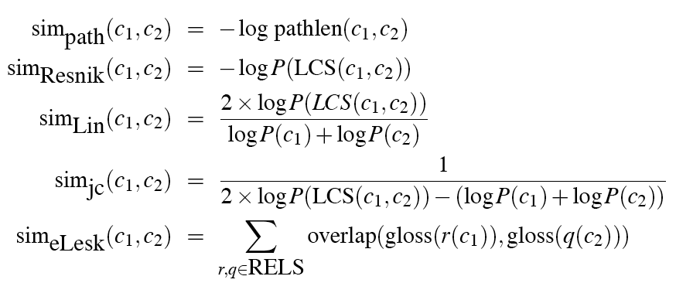
Recap: thesaurus-based similarity

Slide 35
Problems with thesaurus-based methods
We don’t have a thesaurus for every language
Even if we do, many words are missing
Neologisms: retweet, iPad, blog, unfriend, …
Jargon: poset, LIBOR, hypervisor, …
Typically only nouns have coverage
What to do?? Distributional methods.
Notes:
What else is missing from e.g. WordNet?

